Slide 1
Tree
B.Sc. CSIT 3rd Semester

Slide 2
Tree data structure
a) Concept and definition
b) Binary tree
c) Introduction and application
d) operations
e) Types of binary tree
  ✔ Complete binary tree
  ✔ Strictly binary tree
  ✔ Almost complete binary tree
g) Binary search tree
✔ insertion
✔ deletion
✔ searching
h) Tree traversal
✔ Pre-order traversal
✔ In-order traversal
✔ post-order traversal

Slide 3
Tree
In computer science, a tree is an abstract model of a hierarchical structure.
It is used to represent a hierarchical relationship existing among several data items.
A tree consists of nodes with a parent-child relationship.
It is a non-linear data structure.
Searching as fast as in ordered array.
Insertion and deletion as fast as in linked list

Slide 4
Tree is a sequence of nodes.
There is a starting node known as root node.
Every node other than the root has a parent node.
Nodes may have any number of children.

Slide 5
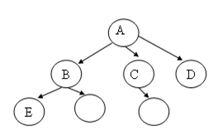

Tree

Slide 6
Graph theoretic definition of a Tree
It is a finite set of one or more data items (nodes) such that
- There is a special data item called the root of the tree
- Its remaining data items are partitioned into number of disjoint subsets, each of which is itself a tree again, called subtrees.

Slide 7
Recursive definition of tree
A tree t of order n is either empty or consists of a distinguished node r, called the root of T, together with at most n trees, T1, T2, …........,Tn called the sub trees of T.

Slide 8
Characteristics of trees
✔ Non-linear data structure
✔ combines advantages of an ordered array
✔ searching as fast as in ordered array
✔ insertion and deletion as fast as in linked list
Application
✔ Directory structure of a file store
✔ Structure of arithmetic expressions
✔ Hierarchy of an organization

Slide 9
Some key terms
Degree of a node:
The degree of a node is the number of children of that node. In above tree the degree of node A is 3.
Degree of a Tree:
The degree of a tree is the maximum degree of nodes in a given tree.
In the above tree the node A has maximum degree, thus the degree of the tree is 3.
Path:
It is the sequence of consecutive edges from source node to destination node. There is a single unique path from the root to any node.

Slide 10
Height of a node:
The height of a node is the maximum path length from that node to a leaf node. A leaf node has a height of 0.
Height of a tree:
The height of a tree is the height of the root.
Depth of a node:
Depth of a node is the path length from the root to that node. The root node has a depth of 0.
Depth of a tree:
Depth of a tree is the maximum level of any leaf in the tree. This is equal to the longest path from the root to any leaf.
Level of a node:
the level of a node is 0, if it is root; otherwise it is one more then its parent.

Slide 11
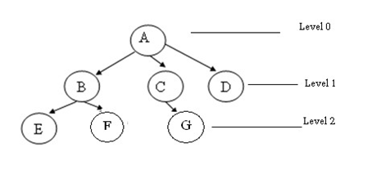
Illustration:

Slide 12
A is the root node
✔ B is the parent of E and F
✔ D is the sibling of B and C
✔ E and F are children of B
✔ E, F, G, D are external nodes or leaves
✔ A, B, C are internal nodes
✔ Depth of F is 2
✔ the height of tree is 2
✔ the degree of node A is 3
✔ The degree of tree is 3

Slide 13
Binary Tree
A binary tree is a finite set of data items which is either empty or consists of a single item called the root and the two disjoint binary trees called the left subtree and right subtree. In a binary tree the maximum degree of any node is at most two. That means, there may be a zero degree node (usually an empty tree) or one degree node or two degree node.

Slide 14
Some properties of a binary tree
Number of external nodes ≤ number of internal nodes + 1
Number of nodes at level i ≤ 2^{i}
Number of external nodes ≤ 2 ^{height}
(Here, height means height of the tree)
Number of nodes in a tree ≤ 2^{height+1}-1
Here, height means height of the tree)

Slide 15
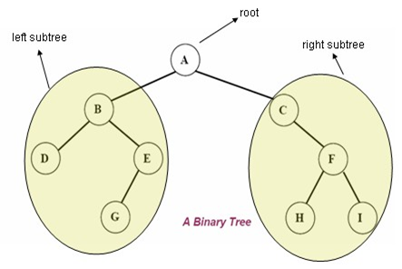

Slide 16
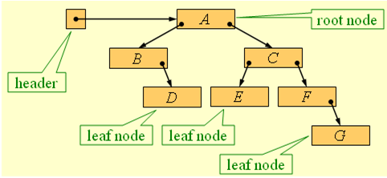

Slide 17
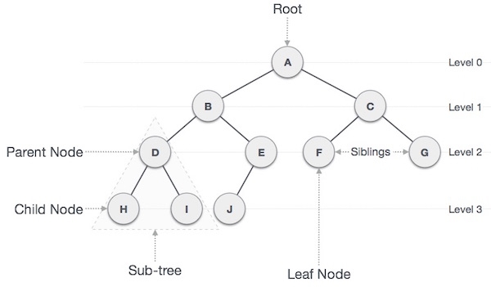

Slide 18
Types of binary tree
✔ Complete binary tree
✔ Strictly binary tree
✔ Almost complete binary tree

Slide 19
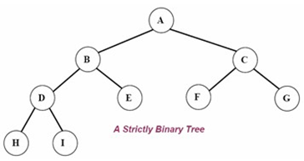
Strictly binary tree:
If every non-leaf node in a binary tree has nonempty left and right sub-trees, then such a tree is called a strictly binary tree.

Slide 20
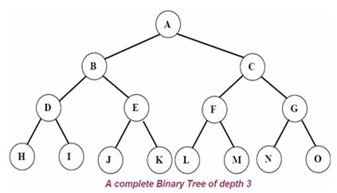
Complete binary tree:
A complete binary tree of depth d is called strictly binary tree if all of whose leaves are at level d.
A complete binary tree with depth d has 2^{d} leaves and 2^{d} -1 non-leaf nodes(internal)
External nodes(leaf node)=No. of internal nodes+1

Slide 21
Almost complete binary tree
A binary tree of depth d is an almost complete binary tree if:
✔ Any node nd at level less than d-1 has two sons.
✔ For any node nd in the tree with a right descendant at level d, nd must have a left son and every left descendant of nd is either a leaf at level d or has two sons.

Slide 22
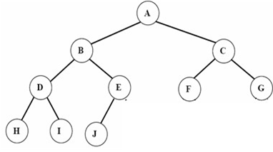
Fig. Almost complete binary tree but not strictly binary tree. Since node E has a left son but not a right son.

Slide 23
Operations on Binary tree
father(n,T):
Return the parent node of the node n in tree T. If n is the root, NULL is returned.
LeftChild(n,T):
Return the left child of node n in tree T. Return NULL if n does not have a left child.
RightChild(n,T):
Return the right child of node n in tree T. Return NULL if n does not have a right child.
Info(n,T):
Return information stored in node n of tree T (ie. Content of a node).
Sibling(n,T):
return the sibling node of node n in tree T. Return NULL if n has no sibling.

Slide 24
Root(T): Return root node of a tree if and only if the tree is nonempty.
Size(T): Return the number of nodes in tree T
MakeEmpty(T): Create an empty tree T
SetLeft(S,T): Attach the tree S as the left sub-tree of tree T
SetRight(S,T): Attach the tree S as the right sub-tree of tree T.
Preorder(T): Traverses all the nodes of tree T in preorder.
postorder(T): Traverses all the nodes of tree T in postorder
Inorder(T): Traverses all the nodes of tree T in inorder.

Slide 25
C representation for Binary tree
struct bnode
{
int info;
struct bnode *left; struct bnode *right;
};
struct bnode *root=NULL;

Slide 26
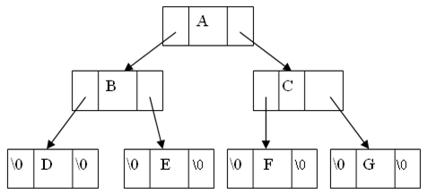
Fig: Structure of Binary tree

Slide 27
Tree traversal
The tree traversal is a way in which each node in the tree is visited exactly once in a symmetric manner.
There are three popular methods of traversal
✔ Pre-order traversal
✔ In-order traversal
✔ Post-order traversal

Slide 28
Pre-order traversal
The preorder traversal of a nonempty binary tree is defined as follows:
✔ Visit the root node
✔ Traverse the left sub-tree in preorder
✔ Traverse the right sub-tree in preorder

Slide 29
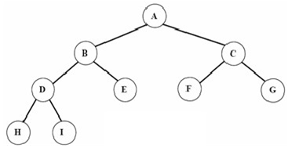
fig. Binary tree

Slide 30
C function for preorder traversing
void preorder(struct bnode *root)
{
if(root!=NULL) {
printf(“%c”, root->info);
preorder(root->left);
preorder(root->right);
} }

Slide 31
In-order traversal
The inorder traversal of a nonempty binary tree is defined as follows:
✔ Traverse the left sub-tree in inorder
✔ Visit the root node
✔ Traverse the right sub-tree in inorder
The inorder traversal output of the given tree is: H D I B E A F C G

Slide 32
C function for inorder traversing
void inorder(struct bnode *root)
{
if(root!=NULL) {
inorder(root->left);
printf(“%c”, root->info);
inorder(root->right);
} }

Slide 33
Post-order traversal
The post-order traversal of a nonempty binary tree is defined as follows:
✔ Traverse the left sub-tree in post-order
✔ Traverse the right sub-tree in post-order
✔ Visit the root node
The post-order traversal output of the given tree is: H I D E B F G C A

Slide 34
C function for post-order traversing
void post-order(struct bnode *root)
{
if(root!=NULL)
{
post-order(root->left);
post-order(root->right);
printf(“%c”, root->info);
} }

Slide 35
Binary search tree(BST)
A binary search tree (BST) is a binary tree that is either empty or in which every node contains a key (value) and satisfies the following conditions:
All data value in the left sub-tree of the root are smaller than the data value in the root node.
All data value in the right sub-tree of the root are greater than the data value in the root node
The left and right sub-trees of the root are again binary search trees
Given the following sequence of numbers,
14, 15, 4, 9, 7, 18, 3, 5, 16, 4, 20, 17, 9, 14, 5

Slide 36
Construct tree

Slide 37
Operations on Binary search tree(BST):
Search(k, T): Search for key k in the tree T. If k is found in some node of tree then return true otherwise return false.
✔ Insert(k, T): Insert a new node with value k in the info field in the tree T such that the property of BST is maintained.
✔ Delete(k, T):Delete a node with value k in the info field from the tree T such that the property of BST is maintained.
✔ FindMin(T), FindMax(T): Find minimum and maximum element from the given nonempty BST.

Slide 38
Searching through the BST
Problem: Search for a given target value in a BST.
Idea: Compare the target value with the element in the root node.
  If the target value is equal, the search is successful.
  If target value is less, search the left subtree.
  If target value is greater, search the right subtree.
  If the subtree is empty, the search is unsuccessful.

Slide 39
BST search algorithm:
To find which if any node of a BST contains an element equal to target: 1. Set curr to the BST’s root.
2. Repeat:
  2.1. If curr is null:
    2.1.1. Terminate with answer none.
2.2. Otherwise, if target is equal to curr’s element:
2.2.1. Terminate with answer curr.
2.3. Otherwise, if target is less than curr’s element:
2.3.1. Set curr to curr’s left child.
2.4. Otherwise, if target is greater than curr’s element:
2.4.1. Set curr to curr’s right child.
2. end

Slide 40
C function for BST searching:
void BinSearch(struct bnode *root , int key) {
if(root == NULL) {
printf(“The number does not exist”);
exit(1);
}
else if (key == root->info) {
printf(“The searched item is found”):
}
else if(key < root->info)
return BinSearch(root->left, key);
else
return BinSearch(root->right, key);
}

Slide 41
insertion of a node in BST
To insert a new item in a tree, we must first verify that its key is different from those of existing elements.
To do this a search is carried out.
If the search is unsuccessful, then item is inserted.
Idea: To insert a new element into a BST, proceed as if searching for that element.
If the element is not already present, the search will lead to a null link.
Replace that null link by a link to a leaf node containing the new element.

Slide 42
Construct tree

Slide 43
BST insertion algorithm:
To insert the element elem into a BST:
Set parent to null, and set curr to the BST’s root.
2. Repeat:
2.1. If curr is null:
2.1.1. Replace the null link from which curr was taken
(either the BST’s root or parent’s left child or parent’s right child) by a link to a newly-created leaf node with element elem.
2.1.2. Terminate.
2.2. Otherwise, if elem is equal to curr’s element:
2.2.1. Terminate.
2.3. Otherwise, if elem is less than curr’s element:
2.3.1. Set parent to curr, and set curr to curr’s left child.
2.4. Otherwise, if elem is greater than curr’s element:
2.4.1. Set parent to curr, and set curr to curr’s right child.
3.End

Slide 44
C function for BST insertion
void insert(struct bnode *root, int item) {
if(root=NULL)
{
root=(struct bnode*)malloc (sizeof(struct bnode));
root->left=root->right=NULL;
root->info=item;
}
else
{
if(item<root->info)
root->left=insert(root->left, item);
else
root->right=insert(root->right, item);
}

Slide 45
Deleting a node from the BST
While deleting a node from BST, there may be three cases:
1. The node to be deleted may be a leaf node:
  In this case simply delete a node and set null pointer to its parents those side at which this deleted node exist.

Slide 46
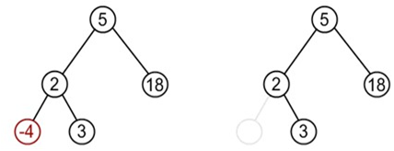
Suppose node to be deleted is -4

Slide 47
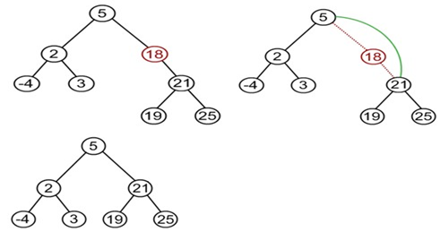
The node to be deleted has one child:
  In this case the child of the node to be deleted is appended to its parent node. Suppose node to be deleted is 18

Slide 48
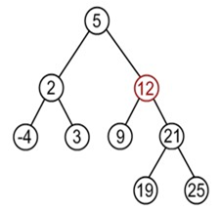
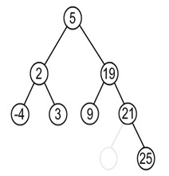
The node to be deleted has two children:
In this case node to be deleted is replaced by its in-order successor node. OR
If the node to be deleted is either replaced by its right sub-trees leftmost node or its left sub-trees rightmost node.
Suppose node to deleted is 12

Slide 49
Find minimum element in the right sub-tree of the node to be removed. In current example it is 19.
General algorithm to delete a node from a BST:
1. start
2. if a node to be deleted is a leaf nod at left side then simply delete and set null pointer to it's parent's left pointer.
3. If a node to be deleted is a leaf node at right side then
simply delete and set null pointer to it's parent's right pointer
4. if a node to be deleted has on child then connect it's child pointer with it's parent pointer and delete it from the tree
5. if a node to be deleted has two children then replace the node being deleted either by
a. right most node of it's left sub-tree or
b. left most node of it's right sub-tree.
6. End

Slide 50
The deleteBST function
struct bnode *delete(struct bnode *root, int item) {
struct bnode *temp;
if(root==NULL){
printf(“Empty tree”); return;
}
else if(item<root->info)
root->left=delete(root->left, item);
else if(item>root->info)
root->right=delete(root->right, item);
else if(root->left!=NULL &&root->right!=NULL){
//node has two child
temp=find_min(root->right);
root->info=temp->info;
root->right=delete(root->right, root->info);
}
else {
temp=root;
if(root->left==NULL)
root=root->right;
else if(root->right==NULL)
root=root->left;
free(temp);
}
return(temp);
}

Slide 51
find minimum element function
struct bnode find_min(struct bnode *root){
if(root==NULL)
return 0;
else if(root->left==NULL)
return root;
else
return(find_min(root->left));
}

Slide 52
Complexity of Binary search tree
 | Average Case | Worst case
Space Complexity | O(n) | O(n)
Search Complexity | O(log n) | O(n)
Insertion Complexity | O(log n) | O(n)
Deletion Complexity | O(log n) | O(n)

Slide 53
Review
tree terminology:
depth of a node is the number of edges from the root to the node.
height of a node is the number of edges from the node to the deepest leaf.
The height of a tree is a height of the root.
Degree :- Degree of a node is equal to number of children, a node have.
Ancestor node :- An ancestor of a node is any predecessor node on a path from root to that node. The root node doesn't have any ancestors.
Path :- The sequence of consecutive edges is called path.

Slide 54
